Slide 1
YCA Wellness Series:
Dealing with uncertainty and
building resilience during COVID-19
Thursday 14 May
Snow Chen – Senior Consulting Psychologist, Revelian
Josh Hickford CA – Co-Founder, Ripple NZ

Slide 2
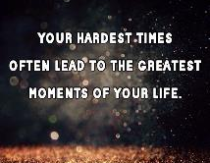
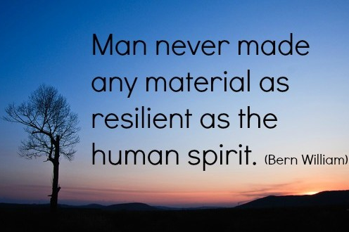

Slide 3
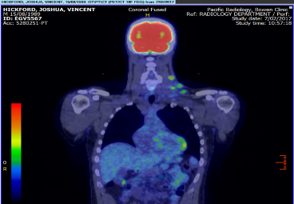
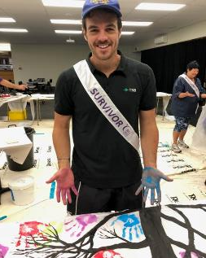
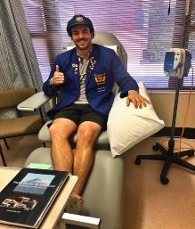
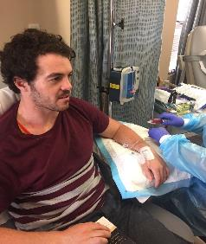
My Cancer Journey
From
Diagnosis
to
Remission
Notes:
Cancer Diagnosis and the struggles along the way
Chemo at the hospital. Radiation at Palmerston North
Work and life went on - Time waits for no person
People’s lives continue
The alternative to not fight was to essentially roll over and die.
strong mind and positive mindset
Only 27 at the time. Not something you expect at that age. No one here EXPECTS to get Cancer but unfortunately is a harsh reality and it is a numbers game. There is probably at least 15/20 people in this room that have had to

Slide 4
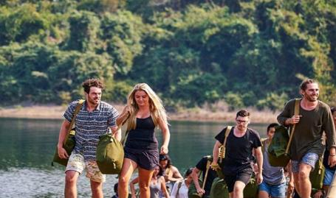
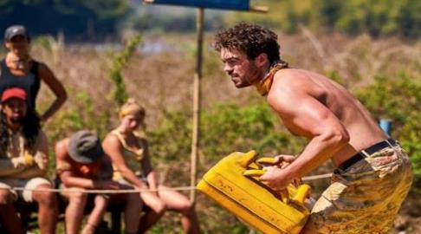
Notes:
WHY DID I APPLY??
It was the hardest fun I have ever had. Being on the island was relentless. No escaping the game or the harsh conditions we lived in.
Watched Season 1 while in Oznam House getting radio therapy and decided I’d apply for Season 2.
2 months in remission I applied and got accepted
Wanted a big challenge an what better challenge than get marooned on an island with strangers
Application process
Stories:
Didn’t eat for 2 days
Looking for food the entire time
Had to show huge resilience during the game
Harsh conditions, Lack of food ,Game situation ,Mental toughness .Blindside and going home
Going on Survivor was felt like standing up to Cancer

Slide 5
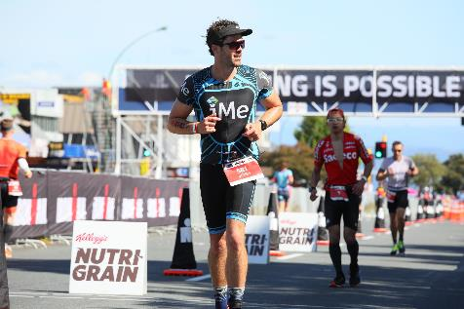
From Cancer to…
New Zealander Sir Edmond Hillary
“It is not the mountain we conquer but ourselves.”
“You don't have to be a fantastic hero to do certain things - to compete. You can be just an ordinary chap, sufficiently motivated to reach challenging goals.”
Notes:
What inspired me during ironman and cancer. Sir Edmond Hillary quotes.
Explain how they relate to not just sport but every day life and especially the business world.
Sir Edmond Hillary quotes:
It is not the mountain we conquer but ourselves.
You don't have to be a fantastic hero to do certain things -- to compete. You can be just an ordinary chap, sufficiently motivated to reach challenging goals.
People do not decide to become extraordinary. They decide to accomplish extraordinary things.
– link back to my journey and also to sport.
Learnings from the day:
no amount of preparation can prepare you for race day
Always expect a hic up to happen
Have a plan B
Train in the heat!!

Slide 6
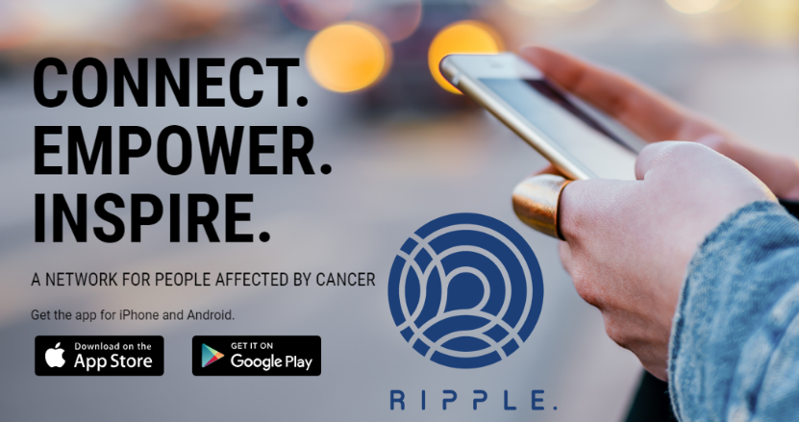

Slide 7
DEALING WITH UNCERTAINTY
& BUILDING RESILIENCE
Chartered Accountants Australia and New Zealand
Young CA Wellness Series
May 2020
SNOW CHEN Senior Consulting Psychologist
Notes:
Hi Everyone. My name is Snow Chen. I’m a senior psychologist from Revelian. My work involves helping organisations harness people’s innate traits to help them feel engaged and a greater sense of wellbeing at work and in their personal lives.
I want to firstly thank you all for dialling in to this wellness meet up about Uncertainty and Resilience and being compassionate and kind to yourself by putting the time and attention to focus on checking in with how you are and striving to find better way to care for yourself.
Every single person on the line today has experienced some degree of change, challenge and uncertainty in the past few months; and
It is this shared experience of the Covid-19 pandemic that has provided us this opportunity to come together, be open and curious, discuss our experiences, and share ways to harness our personal resilience to help cope with what’s happening around us, because there are SO many things and more than ever going on right now. We are going to be reflecting on our own experiences, so I do invite you all to be empathetic and compassionate toward others as everyone’s experience and feelings are valid. If you feel that you require further support please do reach out to professional services available.
Glad that CA accountants has reached out to me to discuss and share thoughts and strategies to build your resilience.

Slide 8
RESILIENCE
... our ability to effectively bounce back
from challenges, demands and stress.
Notes:
We’ll start with defining resilence and in particular our psychological resilience which is our ability to effectively bounce back from challenges, demands and stress.
Resilience is an ability where some people are better at it than others.
This means you can practise strategies and build you resilience. You can think of it like doing resistance training at the gym so your muscles can be stronger.
The resilience strategies are tools that you can add to your mental tool kit to help you tackle life challenges we haven’t come across before. I’m going to refer to a few refer to today. They may or may not work for you. But have a go at exploring them with a sense of curiosity, try it out and determine what fits well into your tool kit.

Slide 9
SELF REFLECTION
Identify thoughts and feelings
Limit external sensory information
Mindfulness, Mediation,
Relaxation, Breathing, Journaling
Take Breaks
Scheduled, Impromptu, Micro
What emotion/s am I feeling?
What do I think about often?
How am I responding?
What is important to me right now?
Notes:
The first strategy for being resilient is understanding your baseline or starting point with self reflection.
It involves identifying and being aware of your inner experience including your thoughts and feelings. Noticing your thinking and emotion you feel allows you to clarify and recognise your own thoughts, feelings and behaviours and allows the opportunity to learn about yourself.
When you have a lot going on around you, it may me difficult to identify what’s going on inside your mind, so limiting external sensory information by closing your eyes, focusing your attention on relaxation or breathing, or even focussing your attention on putting your thoughts and feelings in writing or journaling can help you clarify your thoughts and feelings.
Another is ensuring that you make time to self reflect by taking breaks. This can be scheduled times throughout the week or day; I learnt about signify the beginning and end of your workday when you are working from home by book ending your day. Eg. Walk around the block. Listen to music. Silence.
Microbreak where you look out of the window for 30 seconds can allow you to self reflect.
When you’re reflecting you may ask yourself questions like:
What emotion/s am I feeling?
What do I think about often?
How am I responding?
What is important to me right now?

Slide 10
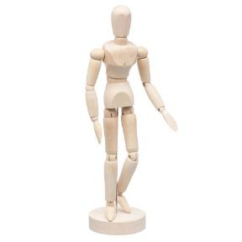
SELF REFLECTION
Identify thoughts and feelings
THINKING
repetitive, negative self talk,
purpose, values
FACE
mouth, between eyes, nose
INTERNAL
temperature, attention,
gaze, heart rate, breath
BODY & BEHAVIOUR
posture, limbs,
muscle tension,
stance, gait, pace,
tone of voice
volume
Notes:
One very important thing to notice when self reflecting are your emotions.
Our emotions are data and information about what we are experiencing.
Emotions are like pieces of information or signals that direct our attention, guide our thoughts and decision making.
We learn the meaning and learn how to interpret the signals that emotions provide, we are able to respond to them effectively.
When identifying emotions, use your senses to check in with non verbal indicators such as your thinking patterns, your facial expression, your body, how you move, and internally like heart rate, how hot and cold you’re feeling.
Every emotion has a unique set of signals that you can attune to. For example: Anger is often experienced through tense muscles, feeling hot, having a furrowed forehead, direct eye gaze, loud voice.

Slide 11
Lonely
Worried
Sad
Excited
Uncertain
Overwhelmed
Frustrated
Confused
Shame
Compassionate
Which emotions have you
felt in the past month?
(Select up to 3)
Notes:
Reflect and identify emotions the past month.
Poll Qu: POLL QU (Anonymous, Multiple Choice):
Which emotions have you felt in the past month? (Select up to 3)
Lonely Worried Sad Excited Uncertain Overwhelmed Frustrated Confused Shame Compassionate
Sometimes emotions are too intense or we are not ready experience it so sometimes we try to avoid them by supressing them by ignoring, or avoiding the experience. If we think of emotions like an inflatable beach ball, if we try to ignore, and supress negative emotions by pushing them down into the water, the longer we do this, the more energy it requires and it does become more difficult. Emotions are informative, this means we’re losing information and data and potentially miss out on opportunities to learn, grow and develop.
We don’t have control over what emotion we’re experiencing but have control over how we experience emotion and how we respond. Being attentive to your emotions allows you to recognise, anticipate and prepare your plan of action to help bounce back and recover.
Emotion beach balls will eventually try to come to the surface so it up to you whether or not you
Even though emotions (pleasant & unpleasant) contain data and can help us make decisions regarding relationships., thinking, decision making, behaviour
You can use some strategies around dealing with negative emotions by trying to understand what they mean first.

Slide 12
UNDERSTAND NEGATIVE EMOTIONS
Lonely, Isolated
Seek out others
Worried, Fear, Anxiety
Potential danger or threat
Confused, Uncertain
Lack of information or clarity
Overwhelmed
Sad, Grief
Frustrated, Angry
Shame, Guilty
Too much change, tasks, intense emotion
Loss - lifestyle, connection, work, loved one
Injustice, Barrier to achieving goal
Internal moral conflict
Notes:
Emotions are all caused by something
They can also change and develop over time
Understand how emotions blend and combine to form other emotions
Find out the reason why certain emotions are experienced – ask questions / discover
Consider and predict the potential emotional consequences of certain situations and decisions
Learn though experience, reflection. Eg. Mood diary
Knowing what caused it and what they are alerting you to how to respond.
Lonely – seek out others
Worried/ (fear, anxiety) – Red flags, Potential danger, Perceived threat
Confused / Uncertain - Lack of information or clarity
Overwhelmed – caused by ongoing emotions, change, tasks,
Sad – (grief), loss of our typical way of living, loss of connection, work, loved one
Frustrated (anger) – Injustice, Wrong – doing, Unfairness / Inequality, Prejudice, Barrier to a achieving a goal
Shame (guilt) – internal moral conflict.

Slide 13
PROLONG POSITIVE EMOTIONS
Gratitude, Appreciation, Thankful
Receiving something
Happy, Joy
Gaining or achieving something that is valuable to us
Hope, Optimism
Expecting a positive outcome in the future
Serenity
Calm, peace, contentment with what you have
Notes:
On the flipside of emotions, we have all the positive ones such as….. Gratitude, joy, hope, serenity.
Our natural human response is to attend to the negative and we often forget to harness the positive emotions.

Slide 14
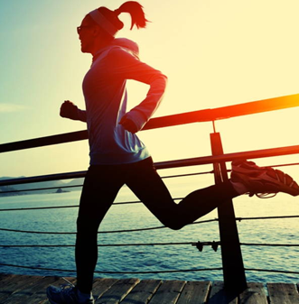
MANAGE YOUR EMOTIONS
BRAIN
PHYSICAL
RELATIONSHIPS
ENVIRONMENT
Self reflection
Reframing
Change perspective
Acknowledge emotion
Identify what you can influence/control
Exercise you enjoy
Relaxation
Breathing
Walking
Meaningful connections
Family
Friends
Colleagues
Neighbours
People you walk by
Nature
Music
Textures
Sunshine
Notes:
Once we
Writing about emotions
Focus on using more positive and negative emotions
Causal phrases “caused me to” and “led me to feel”
Insight words “understand” and “realise”
Try not to stop
Exercise
Manages mood, boosts mood
Brisk walk around the block – 10 mins
Food/Coffee/Energy drinks – temporary and wears off
BRAIN – the way we think about emotions Reappraise – change perspectives Is there another way you can view the situation?
Acknowledge
Bookmark and return
Integrate
Process emotional information

Slide 15
MANAGE NEGATIVE EMOTIONS
Uncertainty
Lack of information
Seek clarity
what information
is available
& useful to you
Stress
Lack resources to cope with demands
Seek resources
we can influence
Knowledge,
skills, time,
emotion
Notes:
Social Media
Information
Financial

Slide 16
PROLONG POSITIVE EMOTIONS
BRAIN
Self reflection
Reframing
Change perspective
Acknowledge emotion
What are some things that you love about your home/being at home
What can you do now that you couldn’t before?
What are you more grateful for?

Slide 17
MANAGE YOUR EMOTIONS
What strategies do you use to:
increase the frequency, intensity and duration of positive emotions?
decrease the frequency, intensity and duration of negative emotions?
BRAIN
PHYSICAL
RELATIONSHIPS
ENVIRONMENT

Slide 18
Snow Chen Senior Consulting Psychologist
Snow.Chen@revelian.com

Slide 19
Breakout Session

Slide 20
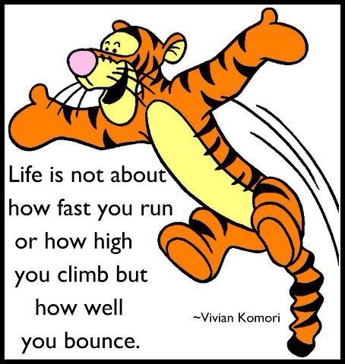
QUESTIONS?
No doubt you have some, ask these in the chat and we can follow them up or reach out on LinkedIn
Notes:
Lastly…..finish with Tiger.

Slide 21
This publication is intended to provide general information and is not intended to provide or substitute legal or professional advice. This publication has been prepared so that is current as at the date of writing. You should be aware that such information can rapidly become out of date. You should not act, or refrain from acting, or rely on any statement, view or opinion expressed in this publication. You should make and rely on your own inquiries in making any decisions or giving any advice. No warranty is given as to the correctness of the information contained in this publication, or of its suitability for use by you. To the fullest extent permitted by law, Chartered Accountants Australia and New Zealand (CA ANZ) is not liable for any statement or opinion, or for any error or omission contained in this publication and disclaims all warranties with regard to the information contained in it, including, without limitation, all implied warranties of merchantability and fitness for a particular purpose. CA ANZ is not liable for any direct, indirect, special or consequential losses or damages of any kind, or loss of profit, loss or corruption of data, business interruption or indirect costs, arising out of or in connection with the use of this publication or the information contained in it, whether such loss or damage arises in contract, negligence, tort, under statute, or otherwise.

